Slide 1
Responding to and Managing an Incident
AWS Academy Cloud Security Foundations
Notes:
Welcome to the Responding to and Managing an Incident module.

Slide 2
Introduction
Responding to and Managing an Incident
Notes:
This first section provides an introduction to the module.

Slide 3
Incident recognition and response
Is a set of information security policies and procedures that you can use to identify, contain, and eliminate cyberattacks
Enables an organization to quickly detect and halt attacks
Helps you to minimize damage and prevent future attacks
Notes:
Incident response is a set of information security policies and procedures that you can use to identify, contain, and eliminate cyberattacks.
The goal of incident response is to enable an organization to quickly detect and halt attacks, which helps to minimize damage and prevent future attacks of the same type.

Slide 4
Recognizing incidents
Not all events are incidents in need of immediate remedy.
Logging in from a remote location
Failing hard drive that is still fully operational
Employee trying to access resources that they shouldn't access
Notes:
How would an enterprise know if abuse was taking place? How would they differentiate between abnormal events that need their attention, and incidents that need immediate analysis and remediation?
Not all events are incidents in need of immediate remedy. Let’s take a look at a few examples of such events:
Logging in from a remote location: An employee might be traveling or using an approved virtual private network (VPN).
Failing hard drive that is still fully operational: Knowing this information allows an enterprise to timely schedule a cycling of the drives without panicking and hot swapping when it's too late and has already failed. Hot swapping is the act of removing components from or plugging them into a computer system while the power remains switched on.
Employee trying to access resources that they shouldn't access: Although this might not constitute a breach if the access was denied, it's still a behavioral insight that you should monitor.

Slide 5
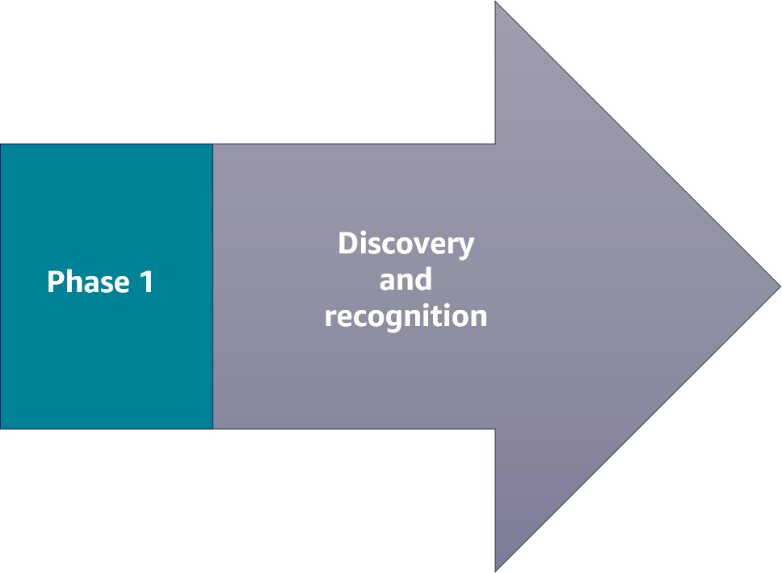
Phase 1: Discovery and recognition
Incident identification, logging, and categorization
Incident notification and escalation
Investigation and diagnosis
Notes:
Incident response has two phases. The first phase is the discovery and recognition phase. Here is where incident identification, logging, and categorization of the incident takes place. Once an incident is identified through user reports, solution analyses, or manual identification, the incident is logged and an investigation and categorization can begin.
During this phase, a notification is received. Notifications are set up by the user and initiated by specified alerts to send an email, SMS text, or push notification through a mobile app. Incident escalation is what happens when an employee can’t resolve an incident themselves and needs to hand off the task to a more experienced or specialized employee.
Investigation and diagnosis includes conducting an incident investigation to gather answers and develop strategies to resolve any threats.
AWS offers a range of services and products that help companies discover and identify events that could lead to, or have already become, an incident.

Slide 6
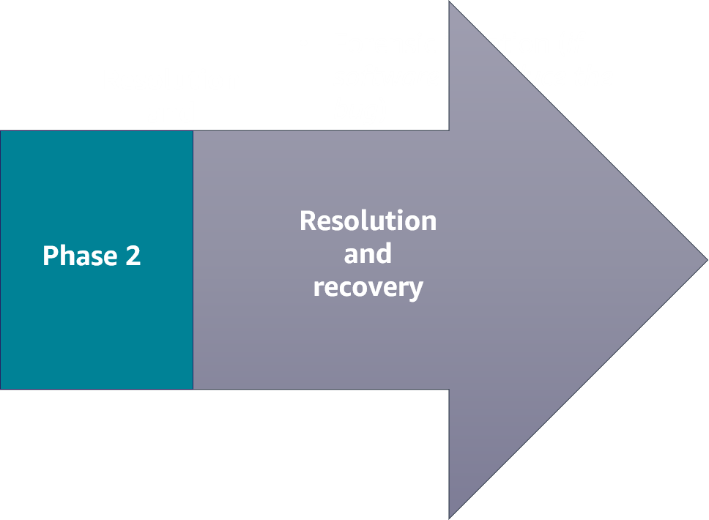
Phase 2: Resolution and recovery
Forensic isolation (if software, reproduce the bug)
Stage a fix
Deploy the fix
Incident closure
Automate theses processes wherever possible, and run game days in staging (safe) environments to fine-tune your corporate-wide incident response process.
Notes:
When an enterprise has identified the failure of a component, a reduction in quality of service, or an exploit in need of remedy, they move into the resolution and recovery phase of incident response.
This second phase consists of the following:
Forensic isolation: Isolate the incident, and perform a deep dive to discover the issue. Forensics often requires capturing the disk image or as-is configuration of an operating system. The problem might be a bug in the code base. If so, then you need to reproduce the error. Without being able to reproduce the error that the customer experienced, you won't be able to fix it.
Staging a fix: Reproduce the issue, apply a fix, and test.
Deploying the fix: Push any new infrastructure, as code, or any new application code to production.
Incident closure: Resolve the incident.
AWS offers a range of services and products that help companies remediate an incident.

Slide 7
Key takeaways: Identifying an incident
Incident response is a set of information security policies and procedures that you can use to identify, contain, and eliminate cyberattacks.
Not all events are incidents in need of immediate remedy.
The first phase of an incident is the discovery and recognition phase.
The second phase of an incident is the resolution and recovery phase.
Notes:
Key takeaways from this section of the module include the following:
Incident response is a set of information security policies and procedures that you can use to identify, contain, and eliminate cyberattacks.
Not all events are incidents in need of immediate remedy.
The first phase of an incident is the discovery and recognition phase.
The second phase of an incident is the resolution and recovery phase.

Slide 8
AWS services that support the discovery and recognition phase
Responding to and Managing an Incident
Notes:
This section highlights a few AWS services that support the discovery and recognition phase. Note that these are not all the AWS services available.

Slide 9






Discovery and recognition phase
AWS Trusted Advisor
Amazon CloudWatch
Amazon Inspector
Amazon GuardDuty
AWS Shield
AWS Config
Notes:
AWS offers several services that support incident discovery and recognition. These services help an enterprise to identify an attack.
This section will describe the following services in more detail and how they support this phase of incident response:
AWS Trusted Advisor
Amazon CloudWatch
Amazon Inspector
Amazon GuardDuty
AWS Shield
AWS Config

Slide 10

AWS Trusted Advisor
Draws upon best practices learned from serving hundreds of thousands of AWS customers
Inspects your AWS environment, and then makes recommendations when opportunities exist to improve performance and help close security gaps
AWS Trusted Advisor
Notes:
The AWS Trusted Advisor service draws upon best practices learned from serving hundreds of thousands of AWS customers. Trusted Advisor inspects your AWS environment, and then makes recommendations when opportunities exist to improve performance and help close security gaps.
If you have an AWS Basic Support or Developer Support plan, you can use the AWS Management Console to access core security checks and all checks for service quotas. If you have a Business, Enterprise On-Ramp, or Enterprise Support plan, you can use the console, AWS Support API, and AWS Command Line Interface (AWS CLI) to access all checks, including cost optimization, security, fault tolerance, performance, and service quotas.
You also can use Amazon EventBridge to monitor the status of Trusted Advisor checks.
For more information, see AWS Trusted Advisor in the AWS Support User Guide at https://docs.aws.amazon.com/awssupport/latest/user/trusted-advisor.html.

Slide 11

Amazon CloudWatch
Provides a reliable, scalable, and flexible monitoring solution that you can start using within minutes
Automatically displays metrics about every AWS service that you use
Provides the ability to create alarms that watch metrics and send notifications
Amazon CloudWatch
Notes:
Amazon CloudWatch provides a reliable, scalable, and flexible monitoring solution that you can start using within minutes. By using this service, you don't need to set up, manage, and scale your own monitoring systems and infrastructure.
The CloudWatch console home page automatically displays metrics about every AWS service that you use. You can additionally create custom dashboards to display metrics about your custom applications and display custom collections of metrics that you choose.
You can create alarms that watch metrics and send notifications or automatically make changes to the resources you are monitoring when a threshold is breached.
With CloudWatch, you gain system-wide visibility into resource utilization, application performance, and operational health.
For more information, see the Amazon CloudWatch User Guide at https://docs.aws.amazon.com/AmazonCloudWatch/latest/monitoring/WhatIsCloudWatch.html.

Slide 12

Amazon Inspector
Is a vulnerability management service that continuously scans your AWS workloads for vulnerabilities
Automatically discovers and scans Amazon Elastic Compute Cloud (Amazon EC2) instances and container images that reside in Amazon Elastic Container Registry (Amazon ECR)
Creates a finding when it discovers a vulnerability or network issue
Amazon Inspector
Notes:
Amazon Inspector is a vulnerability management service that continuously scans your AWS workloads for vulnerabilities. Amazon Inspector automatically discovers and scans Amazon Elastic Compute Cloud (Amazon EC2) instances and container images that reside in Amazon Elastic Container Registry (Amazon ECR) for software vulnerabilities and unintended network exposure.
When Amazon Inspector discovers a software vulnerability or network issue, the service creates a finding. A finding describes the vulnerability, identifies the affected resource, rates the severity of the vulnerability, and provides remediation guidance.
For more information, see the Amazon Inspector User Guide at https://docs.aws.amazon.com/inspector/latest/user/what-is-inspector.html.

Slide 13

Amazon GuardDuty
Is a continuous security monitoring service
Identifies unexpected and potentially unauthorized or malicious activity
Uses threat intelligence feeds
Amazon GuardDuty
Notes:
Amazon GuardDuty is a continuous security monitoring service. It can help to identify unexpected and potentially unauthorized or malicious activity in your AWS environment.
The service uses threat intelligence feeds, such as lists of malicious IP addresses and domains, and machine learning to identify unexpected and potentially unauthorized and malicious activity within your AWS environment. This can include issues such as escalations of privileges, use of exposed credentials, or communication with malicious IP addresses or domains. For example, GuardDuty can detect compromised EC2 instances serving malware or mining bitcoin. The service also monitors AWS account access behavior for signs of compromise, such as unauthorized infrastructure deployments (for example, instances being deployed in a Region that has never been used) and unusual API calls (for example, a password policy change to reduce password strength).
For more information, see the Amazon GuardDuty User Guide at https://docs.aws.amazon.com/guardduty/latest/ug/what-is-guardduty.html.

Slide 14

AWS Shield
Automatically protects an enterprise network from a distributed denial of service (DDoS) attack
Offers the AWS Shield Advanced managed threat protection service to improve your security posture with additional DDoS detection, mitigation, and response capabilities
AWS Shield
Notes:
AWS Shield helps protect an enterprise network against a distributed denial of service (DDoS) attack. A DDoS attack is a malicious attempt to disrupt the normal traffic of a targeted server, service, or network by overwhelming the target or its surrounding infrastructure with a flood of internet traffic. From a high level, a DDoS attack is like an unexpected traffic jam clogging up the highway, preventing regular traffic from arriving at its destination.
When you build your application on AWS, you receive automatic protection against common DDoS attacks. Additionally, you can use the AWS Shield Advanced managed threat protection service to improve your security posture with additional DDoS detection, mitigation, and response capabilities.
For more information, see AWS Shield in the AWS WAF, AWS Firewall Manager, and AWS Shield Advanced Developer Guide at https://docs.aws.amazon.com/waf/latest/developerguide/shield-chapter.html.

Slide 15

AWS Config
Is a continuous monitoring and assessment service
Provides the ability to view current and historic configurations of a resource and use this information to troubleshoot outages
Sends notifications when changes occur
Integrates with other AWS services to remediate issues
AWS Config
Notes:
AWS Config is a continuous monitoring and assessment service that provides you with an inventory of your AWS resources and records changes to the configuration of those resources. You can view current and historic configurations of a resource, and use this information to troubleshoot outages and conduct security attack analyses. You can also view the configuration at any point in time and use that information to reconfigure your resources and bring them into a steady state during an outage situation.
AWS Config sends notifications when changes occur, and integrates with other AWS services to remediate issues.
For more information, see the AWS Config User Guide at https://docs.aws.amazon.com/config/latest/developerguide/WhatIsConfig.html.

Slide 16
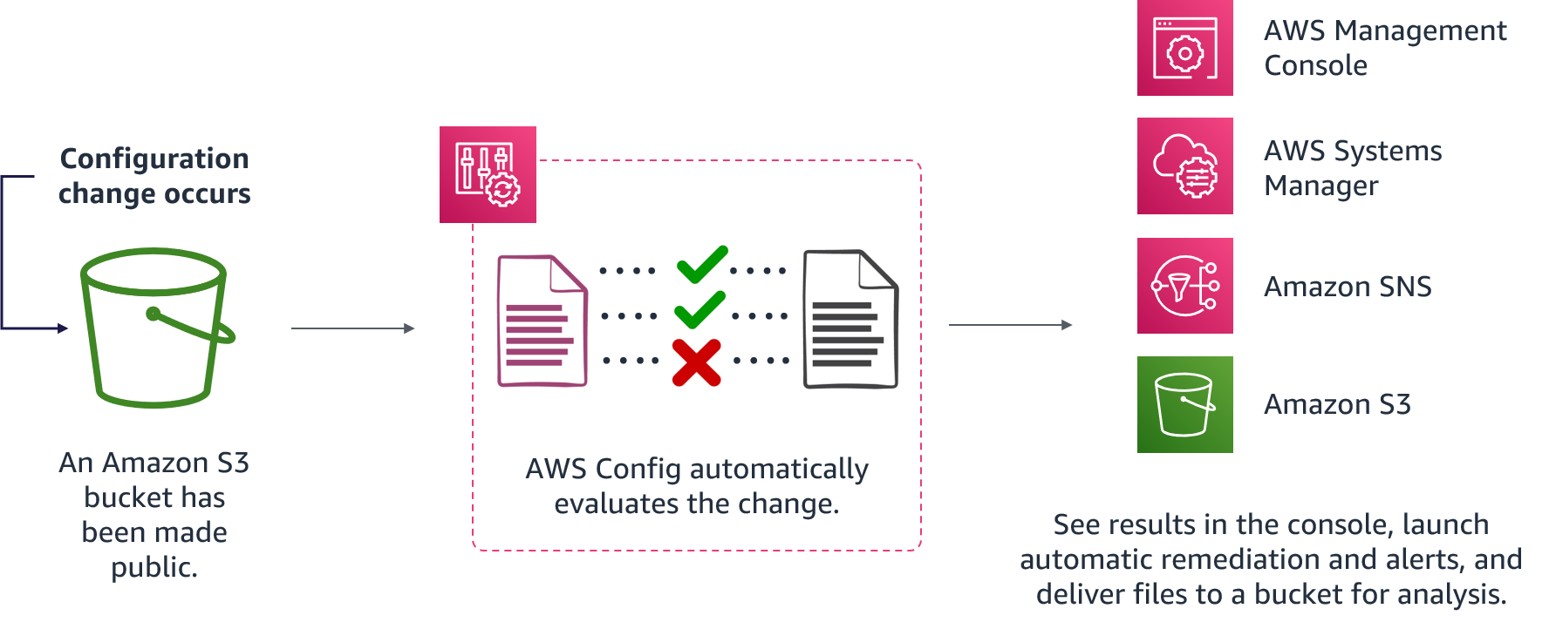
Evaluating rules
Notes:
For accessibility: Diagram of evaluating AWS Config rules. A configuration change occurs. In this example, an S3 bucket has been made public. AWS Config automatically evaluates the change. Results can be viewed in the console. Systems Manager and Amazon SNS are used to invoke automatic remediation and alerts. Files are delivered to an S3 bucket for analysis. End of accessibility description.
As configuration changes occur in your AWS resources, AWS Config records and normalizes the changes into a consistent format. AWS Config automatically evaluates the recorded changes against the rules that you have set. You can then access the change history and compliance results by using the console or API. You can configure Systems Manager or Amazon SNS to be invoked, and remediate or alert you when changes happen. You can also deliver the change history and snapshot files of the monitored resources to an S3 bucket for analysis.

Slide 17
AWS services that support the resolution and recovery phase
Responding to and Managing an Incident
Notes:
This section highlights a few services that support the resolution and recovery phase. Note that these are not all the AWS services available.

Slide 18





Resolution and recovery
AWS Systems Manager
AWS CloudFormation
Event-driven responses
Amazon Simple Notification Service (Amazon SNS)
AWS Step Functions
AWS Lambda
Notes:
AWS offers several different services that help with resolution and recovery.
This section will describe the following services in more detail and how they support this phase of incident response:
AWS Systems Manager
AWS CloudFormation
Amazon Simple Notification Service (Amazon SNS)
AWS Step Functions
AWS Lambda
Lambda, Amazon SNS, and Step Functions are all event-driven response services. An event-driven response is a computer program that is written to respond to actions generated by the user or the system.

Slide 19

AWS Systems Manager
Gives you visibility and control of your infrastructure on AWS
Provides a unified user interface so that you can view operational data from multiple AWS services
Provides the ability to group resources by application and view operational data for monitoring and troubleshooting
Helps you to keep your instances in their defined state and perform on-demand changes, such as updating applications or running shell scripts
AWS Systems Manager
Notes:
AWS Systems Manager gives you visibility and control of your infrastructure on AWS. Systems Manager provides a unified user interface so you can view operational data from multiple AWS services and automate operational tasks across your AWS resources. With Systems Manager, you can group resources by application, view operational data for monitoring and troubleshooting, and take action on your groups of resources. Systems Manager can help you to keep your instances in their defined state and perform on-demand changes, such as updating applications or running shell scripts. The service can also help you to perform other automation and patching tasks.
For more information, see the AWS Systems Manager User Guide at https://docs.aws.amazon.com/systems-manager/latest/userguide/what-is-systems-manager.html.

Slide 20

AWS CloudFormation
Helps you model and set up your AWS resources so that you can spend less time managing those resources and more time focusing on your applications that run in AWS
Provides the ability to create a template that describes all the AWS resources that you want
Can be used to re-create a staging environment inside an isolated, or forensic, virtual private cloud (VPC)
AWS CloudFormation
Notes:
AWS CloudFormation is a service that helps you model and set up your AWS resources so that you can spend less time managing those resources and more time focusing on your applications that run in AWS. You create a template that describes all the AWS resources that you want, and CloudFormation takes care of provisioning and configuring those resources for you. You don't need to individually create and configure AWS resources and figure out what's dependent on what; CloudFormation handles that.
An enterprise can use CloudFormation to recreate a staging environment inside an isolated, or forensic, virtual private cloud (VPC). Once the system is isolated, the team can deep dive and discover the issue, possibly reproduce the issue, apply a fix, and test. Then, the team can push any new infrastructure, as code, or any new application code to production.
For more information, see the AWS CloudFormation User Guide at https://docs.aws.amazon.com/AWSCloudFormation/latest/UserGuide/Welcome.html.

Slide 21

Amazon Simple Notification Service (Amazon SNS)
Is an event-driven web service that provides the ability for applications, end users, and devices to instantly send and receive notifications from the cloud
Amazon Simple Notification Service (Amazon SNS)
Notes:
Amazon Simple Notification Service (Amazon SNS) is an event-driven web service that provides the ability for applications, end users, and devices to instantly send and receive notifications from the cloud.
Amazon SNS and Lambda are integrated, so you can invoke Lambda functions with Amazon SNS notifications. When a message is published to an Amazon SNS topic that has a Lambda function subscribed to it, the Lambda function is invoked with the payload of the published message. The Lambda function receives the message payload as an input parameter and can manipulate the information in the message, publish the message to other SNS topics, or send the message to other AWS services.
An enterprise can use Amazon SNS to receive notifications of potential exploits.
For more information, see the Amazon Simple Notification Service Developer Guide at https://docs.aws.amazon.com/sns/latest/dg/welcome.html.

Slide 22

AWS Step Functions
Is a visual workflow service that developers use to build distributed applications, and automate IT and business processes
Provides the ability to create event-driven workflows to manage failures, retries, parallelization, service integrations, and observability so that developers can focus on higher value business logic
AWS Step Functions
Notes:
AWS Step Functions is a low-code, visual workflow service that developers use to build distributed applications, automate IT and business processes, and build data and machine learning pipelines using AWS services. Event-driven workflows manage failures, retries, parallelization, service integrations, and observability so that developers can focus on higher value business logic.
When an enterprise experiences abnormalities, implementing Step Functions can help you to create complex business logic in event-driven workflows that connect services, systems, or people within minutes.
For more information, see the AWS Step Functions Developer Guide at https://docs.aws.amazon.com/step-functions/latest/dg/welcome.html.

Slide 23

AWS Lambda
Is a serverless, event-driven compute service that provides the ability to run code on demand without provisioning or managing servers
Lambda functions are stateless
AWS Lambda
Notes:
AWS Lambda is a serverless, event-driven compute service that provides the ability to run code on demand without provisioning or managing servers. You pay only for the compute time that you consume, and you aren't charged when your code is not running. With Lambda, you can run code for virtually any type of application or backend service, all with no administration. Just upload your code, and Lambda takes care of everything required to run and scale your code with high availability. You can set up your code to be automatically invoked from other AWS services or call it directly from any web or mobile app.
Lambda functions are stateless, with no affinity to the underlying infrastructure. This means that Lambda can rapidly launch as many copies of the function as needed to scale to the rate of incoming events. After you upload your code to Lambda, you can associate your function with specific AWS resources, such as a particular Amazon Simple Storage Service (Amazon S3) bucket or SNS topic. Then, when the resource changes, Lambda runs your function and manages the compute resources as needed to keep up with incoming requests.
If you need to store secrets to access external services, you can use the AWS Key Management Service (AWS KMS) to store and retrieve the secrets within your Lambda function.
How a Lambda function is invoked depends on the event source that you use with it:
For event-based invocation, some event sources can publish events to Lambda and directly invoke your Lambda function. This is called the push model, where the event sources invoke your Lambda function.
Some event sources publish events, but Lambda must poll the event source and invoke your Lambda function when events occur. This is called the pull model.
Request-response invocation causes Lambda to run the function synchronously and return the response immediately to the calling application. This invocation type is available for custom applications.
For more information, see the AWS Lambda Developer Guide at https://docs.aws.amazon.com/lambda/latest/dg/welcome.html.

Slide 24
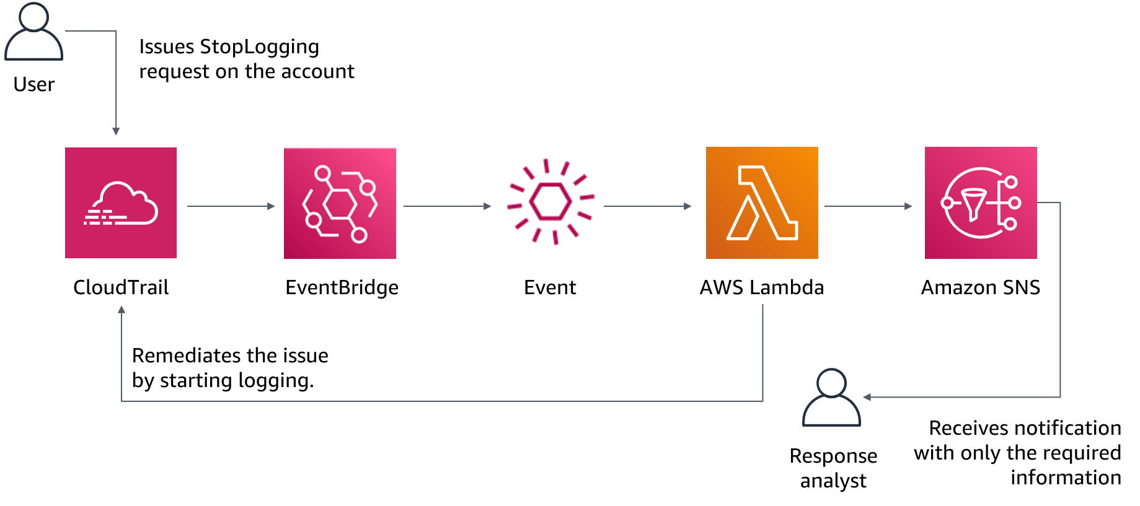
Lambda for incident response
Notes:
For accessibility: Diagram of using Lambda for incident response. User issues a StopLogging request to CloudTrail. CloudTrail and EventBridge invoke a Lambda function to automatically remediate the event. Processed information is sent as an SNS notification to a response analyst. Another Lambda function is invoked automatically to restart the logging. End of accessibility description.
With an event-driven response system, a detective mechanism invokes a responsive mechanism to automatically remediate the event. You can use event-driven response capabilities to reduce the time-to-value between detective mechanisms and responsive mechanisms. To create this event-driven architecture, you can use Lambda.
For example, assume that you have an AWS account with the AWS CloudTrail service enabled. If CloudTrail is ever disabled, the response procedure is to enable the service again and investigate the user who disabled the CloudTrail logging. You can use EventBridge to monitor for the specific “cloudtrail:StopLogging” event and invoke the function if it occurs. When EventBridge invokes this Lambda function, the function collects the details of the specific event. The details include information such as the identity of the principal that disabled CloudTrail, when it was disabled, and the specific resource that was affected. This processed information could then be sent as a notification through Amazon SNS. You can use this information to essentially perform a log dive and then generate a notification or alert with only the specific values that a response analyst would require. Another Lambda function could also be invoked to automatically restart the logging.

Slide 25
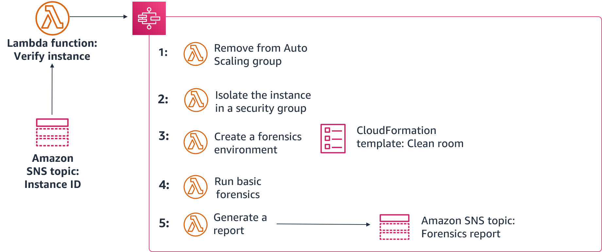
Working together for incident response
Notes:
This slide provides an example of how to use Step Functions, Lambda, CloudFormation, and Amazon SNS to remediate a compromised instance. First, a script or third-party tool pushes an instance ID to an SNS topic. Then, a Lambda function verifies the ID and, if compromised, initiates the following Step Functions workflow:
The instance is removed from its Auto Scaling group, and a snapshot is created of any attached Amazon Elastic Block Store (Amazon EBS) volumes.
The instance is isolated by removing all its previously associated security groups. Then, a new forensics security group is assigned to the instance with no inbound or outbound permissions.
A CloudFormation template is used to create a new environment, including a new VPC that contains a forensics instance with prebuilt tools attached to a copy of any volumes from the snapshots.
A basic forensics investigation is performed on the attached volumes.
A report is then generated with the results from the investigation and sent to the team through an SNS topic.

Slide 26

Lab: Remediating an Incident by Using AWS Config and Lambda
Notes:
You will now complete the Remediating an Incident by Using AWS Config and Lambda lab.

Slide 27
Lab: Tasks
Examining and updating IAM roles
Setting up AWS Config to monitor resources
Modifying a security group that AWS Config monitors
Creating and running an AWS Config rule that calls a Lambda function
Revisiting the security group configuration
Using CloudWatch logs for verification
Notes:
In this lab, you will complete the following tasks:
Examining and updating IAM roles
Setting up AWS Config to monitor resources
Modifying a security group that AWS Config monitors
Creating and running an AWS Config rule that calls a Lambda function
Revisiting the security group configuration
Using CloudWatch logs for verification

